Slide 1
ML and AI in Cybersecurity Defense
Cybersecurity
Lesson 2.2

Slide 2
By the end of today’s class, you will:
1
Understand how AI is used in cybersecurity defense.
2
Learn about specific AI/ML techniques for threat detection and prevention.
3
Gain hands-on experience with AI tools used in cybersecurity defense.

Slide 3

AI and ML Techniques for Cybersecurity Defense

Slide 4



AI and ML Techniques for Cybersecurity Defense
AI is a crucial tool in protecting systems from cyber threats.
AI and ML techniques significantly enhance our ability to detect and respond to cyber attacks in real-time.
Automation and efficiency
Real-time analysis
Managing data volumes

Slide 5



AI and ML Techniques for Threat Detection
Three primary methods:
Anomaly detection
Signature-based detection
Behavioral analysis
Identifies deviations from normality. Crucial for spotting potential security breaches that don't match any known patterns.
Signature-based detection uses known patterns of malicious activity to detect threats.
Behavioral analysis monitors user behavior for suspicious activities.

Slide 6

AI and ML also plays a crucial role in preventing threats.

Slide 7
AI and ML in Threat Prevention

Slide 8



AI and ML in Threat Prevention
Download sample
Visit VirusTotal
Upload and scan the file
Analyze the results

Slide 9
Identifying Virus Threats
In this activity, you will use AI to analyze several viruses and how to mitigate their effects.
15 Minutes

Slide 10
20 Minutes

Slide 12


Predictive Analytics
Automated Responses
Analyzing historical data to forecast future threats
Automatically responding to detected threats

Slide 13

AI and ML to Prevent
Phishing Attacks

Slide 14
Phishing involves fraudulent attempts to obtain sensitive information by pretending to
be a trustworthy entity.

Slide 15
AI models can be trained
to recognize common
phishing tactics.

Slide 16




Natural Language Processing
Analyzes text content of emails and messages
Detecting phishing attempts by identifying unusual phrasing,
grammatical errors, or urgency cues
SUBJECT: URGENT!
Dear: Customer
We requires you to verify your account…

Slide 17
URL Analysis
Examines URLs for signs of phishing
Identifying fraudulent websites designed to mimic legitimate ones, such as slight misspellings of popular domain names.
https://micrsoft.com.office

Slide 18



Machine Learning Classification
Uses supervised learning models to classify emails and websites
Training a classifier on a dataset of known phishing and legitimate
emails to distinguish between them.
login

Slide 19
Identifying Spam with AI

Slide 20
Dear Valued User,
Congratulations!
You have been selected randomly to win the
GRAND PRIZE of $1,000,000 from the Global Lottery Commission.
Click the link below to claim your prize immediately. This offer is only valid for the next 24 hours.
Claim your prize now
Best regards,
Global Lottery Team

Slide 21
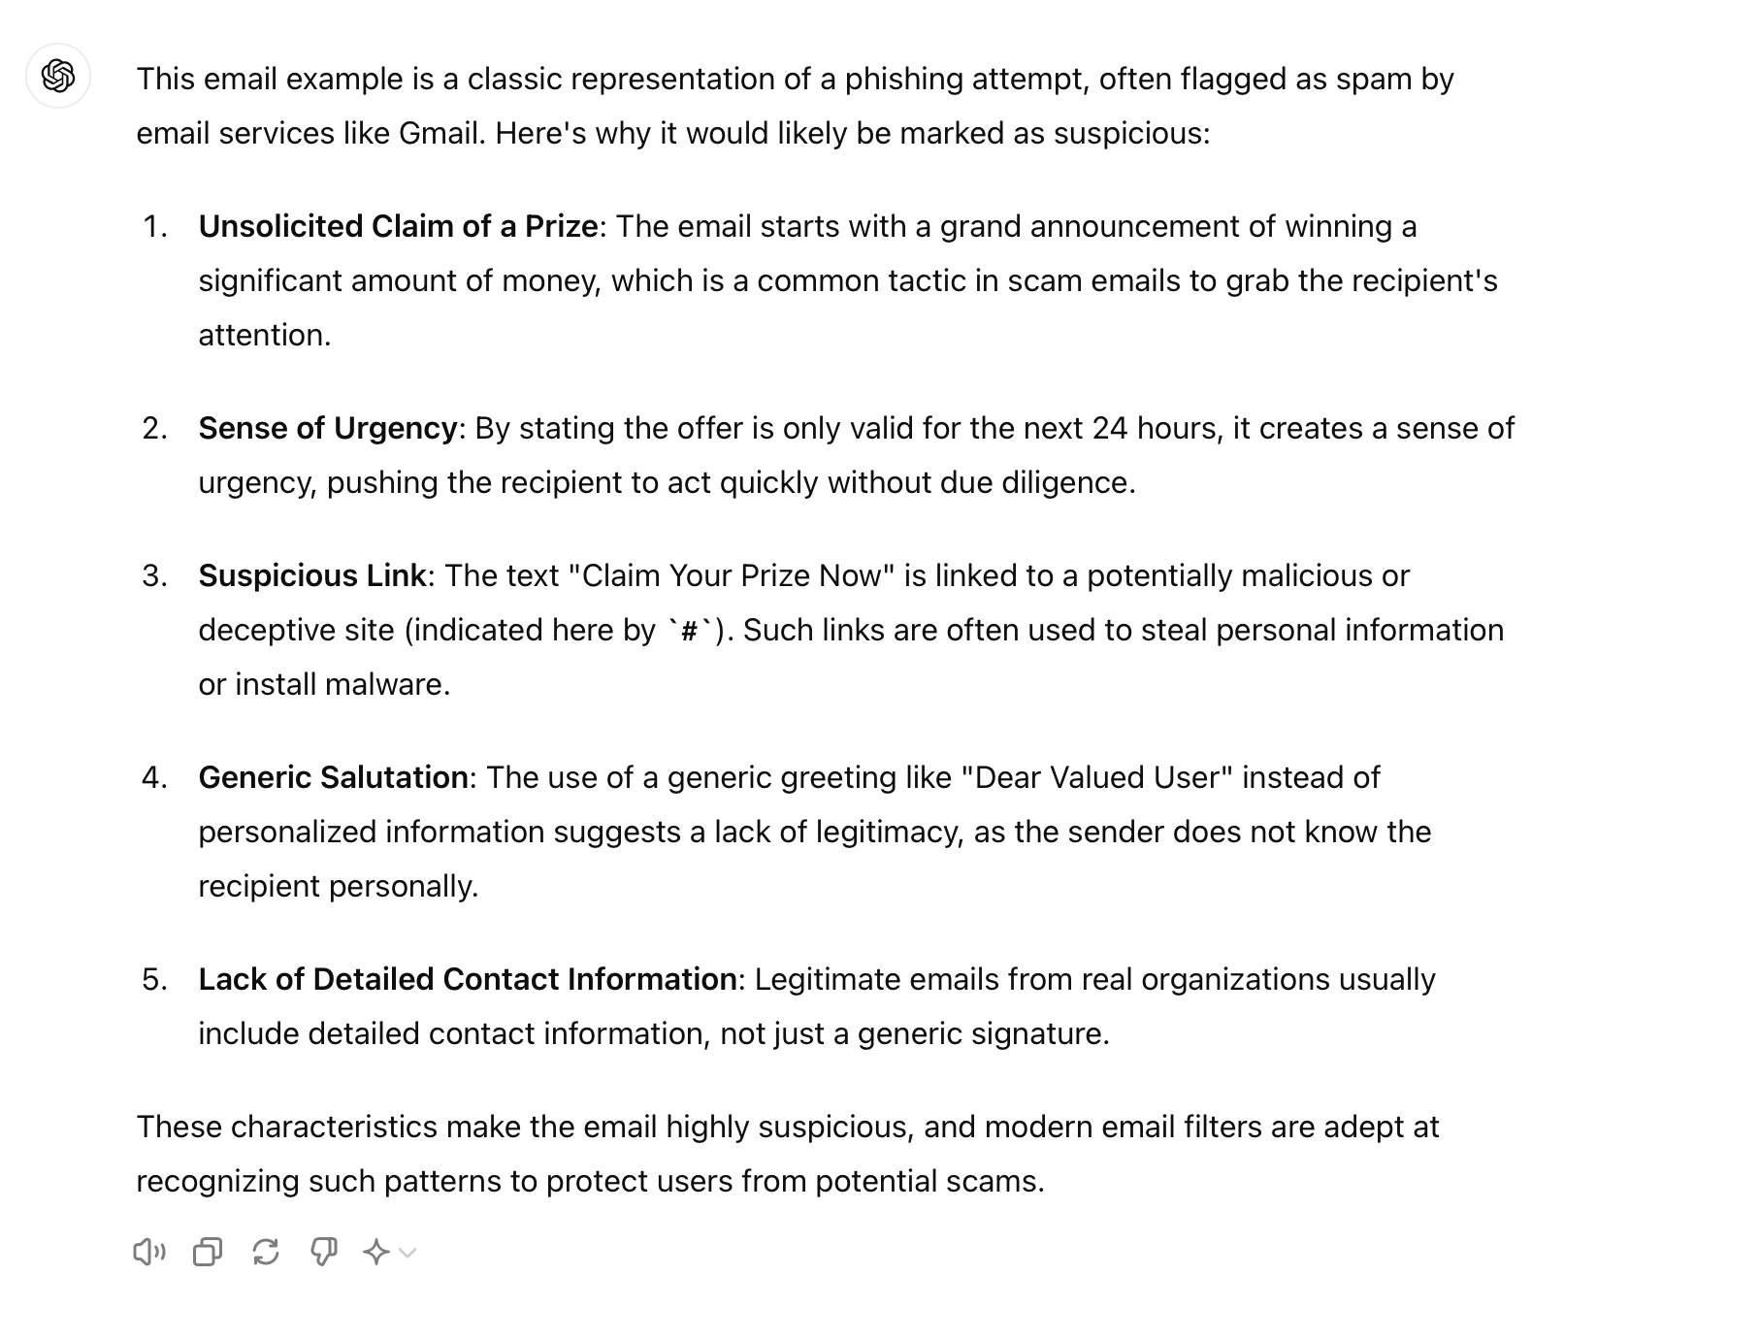

Slide 22
Identifying Spam with AI and ML
In this activity, you will be analyzing several emails to see if AI will categorize them as legitimate or malicious.
15 Minutes

Slide 24

Identifying Email Threats with AI
Common themes ChatGPT discovered
01
Analysis personalization
02
Content and offer
03
Call to action
04
Urgency
05
Sender information

Slide 27
AI and ML Techniques for Malware Detection

Slide 28
Malware comes in various forms, each with its unique characteristics and methods of attack.

Slide 29

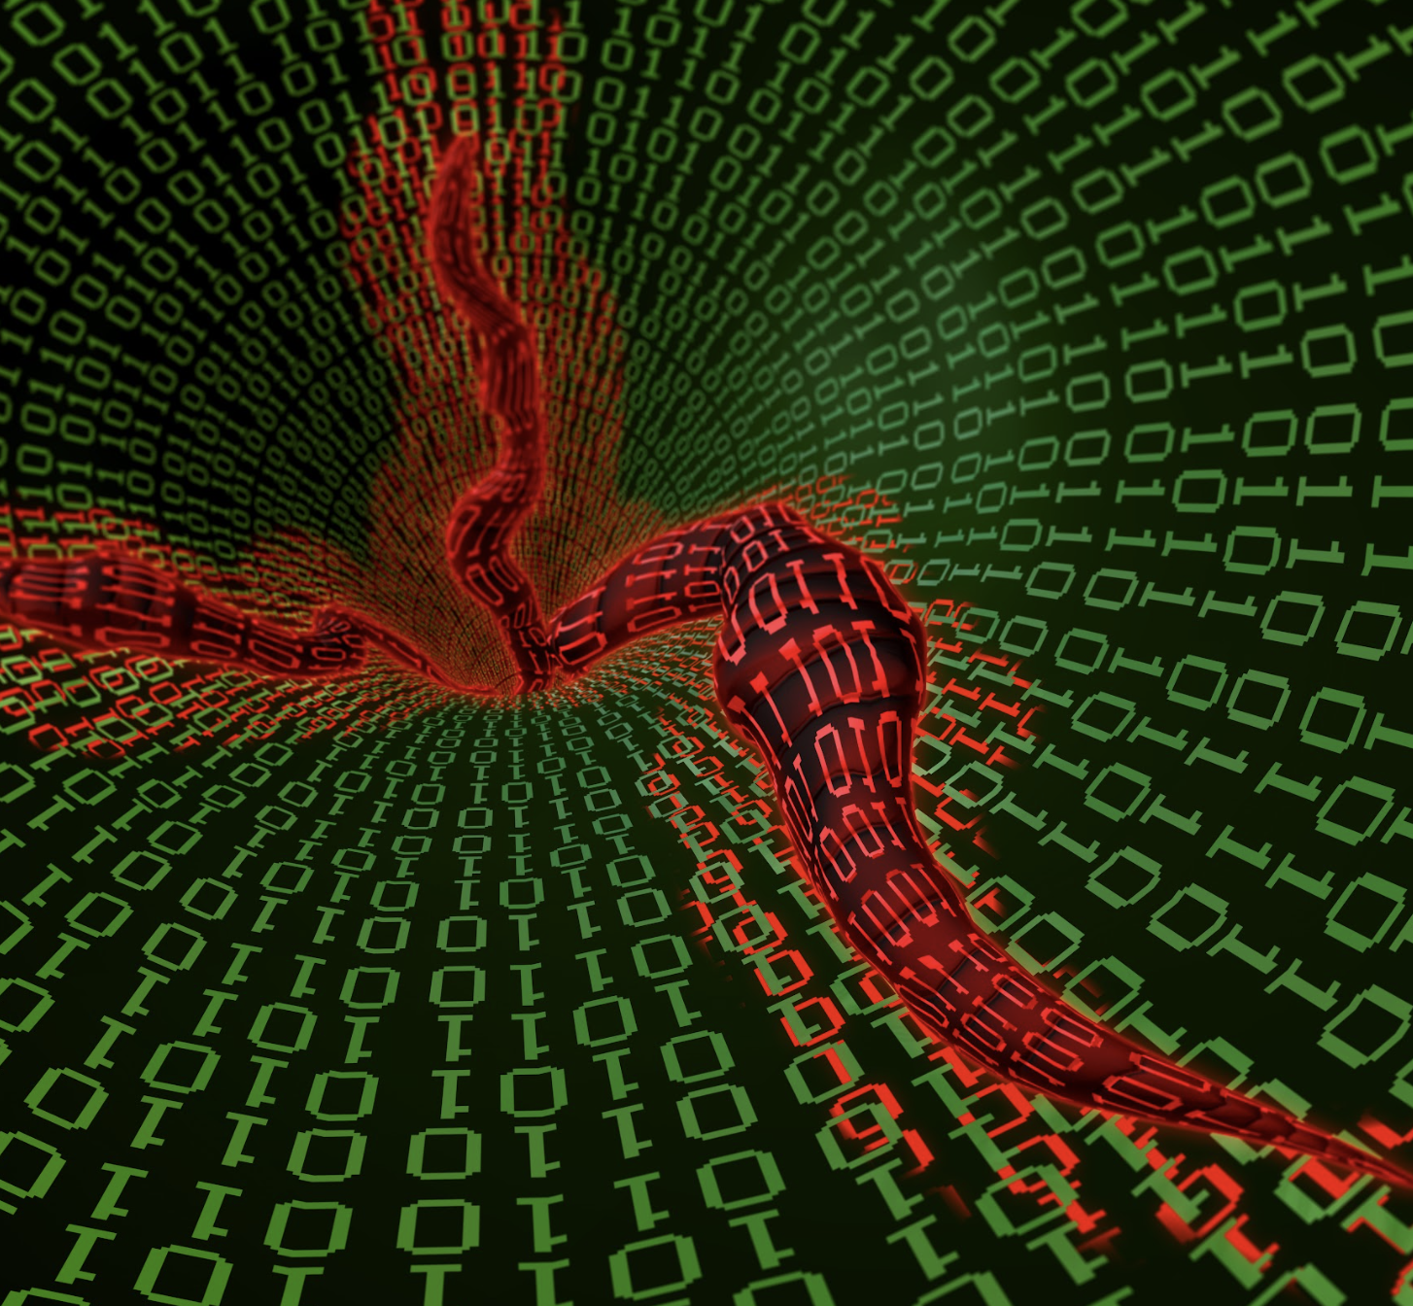
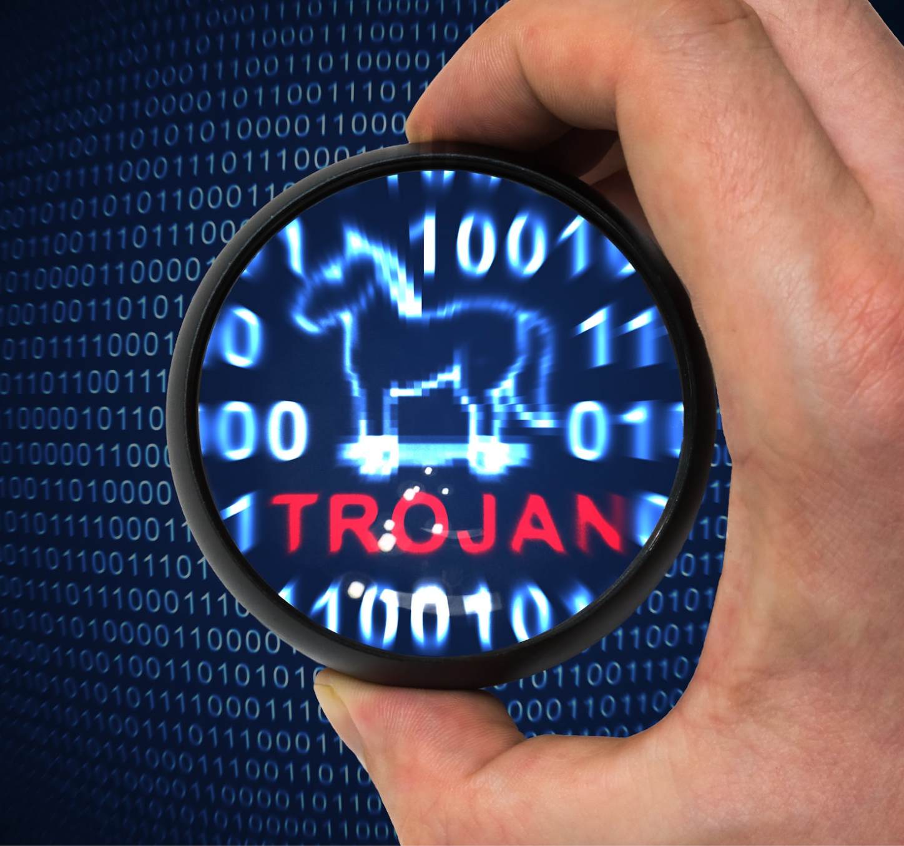
Types of Malware
Viruses:
Malicious code that attaches itself to files and spreads within a computer
Worms:
Malware that replicates itself to spread to other computers
Trojans:
Malicious software disguised as legitimate software

Slide 30
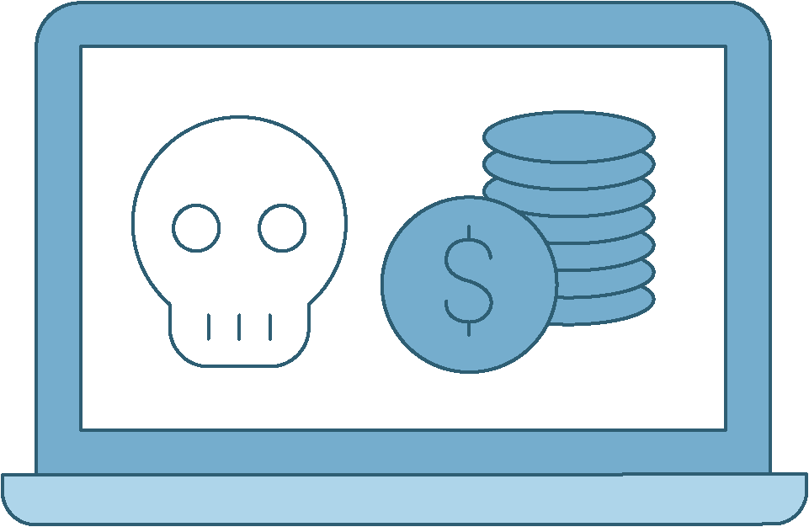

Types of Malware
Ransomware:
Malware that encrypts the victim's data and demands
a ransom
Spyware:
Software that secretly observes user’s activities
and reports it to the software's author

Slide 31


Using AI and ML to Detect and Analyze Malware
Data analysis
Pattern recognition
AI models can be trained to recognize common malware characteristics and behaviors. This allows them to detect even new and unknown malware types based on their actions rather than relying solely on known signatures.
01
02
AI and ML can analyze large volumes of data to identify patterns and signatures indicative of malware.

Slide 32

Antivirus Software
Tools like Windows Defender and Norton use AI and ML to detect and analyze malware.
Continuously updated databases
Uses advanced algorithms to identify
and mitigate threats
Can recognize known and new malware

Slide 33

Security Information and Event Management (SIEM) Systems
Integrate AI and ML for real-time malware detection
and response
Collect and analyze security data from various sources
Enable rapid neutralization
Provide real-time monitoring and response capabilities

Slide 34
Identifying Malware

Slide 35

ChatGPT: “Summarize how the Wineloader malware works and its effects.”

Slide 36
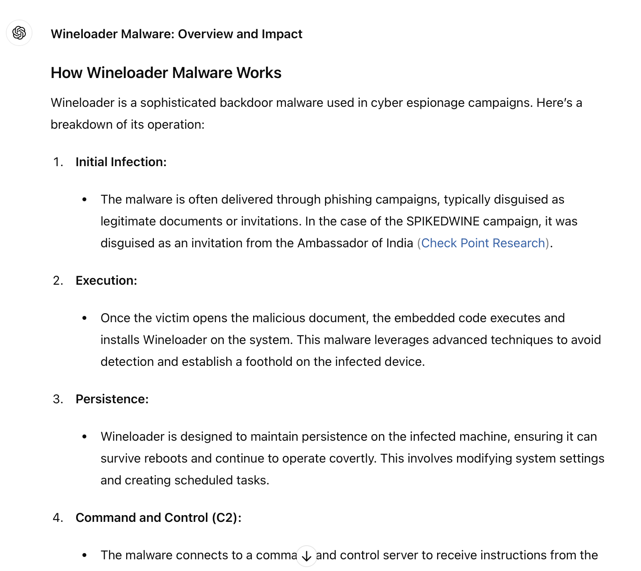

Slide 37
ChatGPT: “How do you mitigate this malware?”

Slide 38
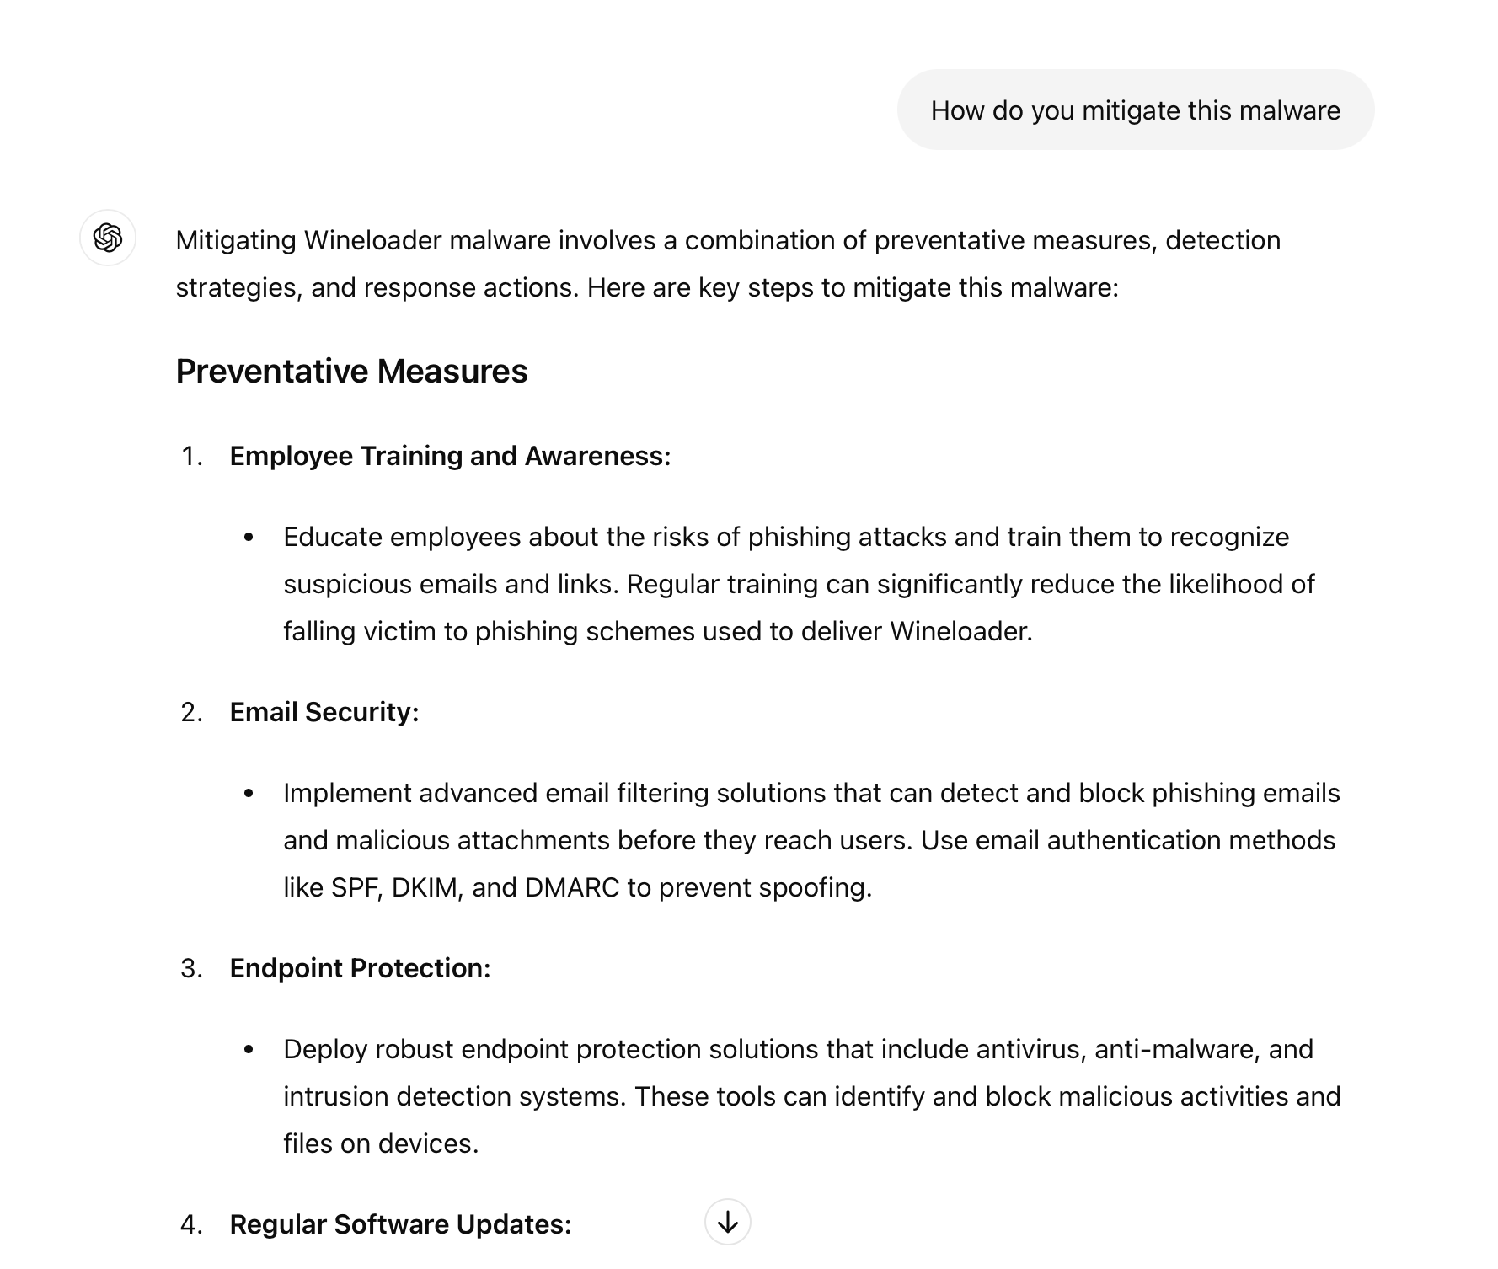

Slide 39
Identifying Malware with AI and ML
In this activity, you will be researching common malware programs
and how to mitigate the damage.
20 Minutes

Slide 43

Recap
ML and AI in Cybersecurity Defense
01
AI/ML play a critical role in detecting and preventing malware.
02
There are different malware types.
03
AI/ML can analyze data to identify malware patterns and behaviors.
04
AI/ML is used in antivirus software and SIEMs.

